Slide 1
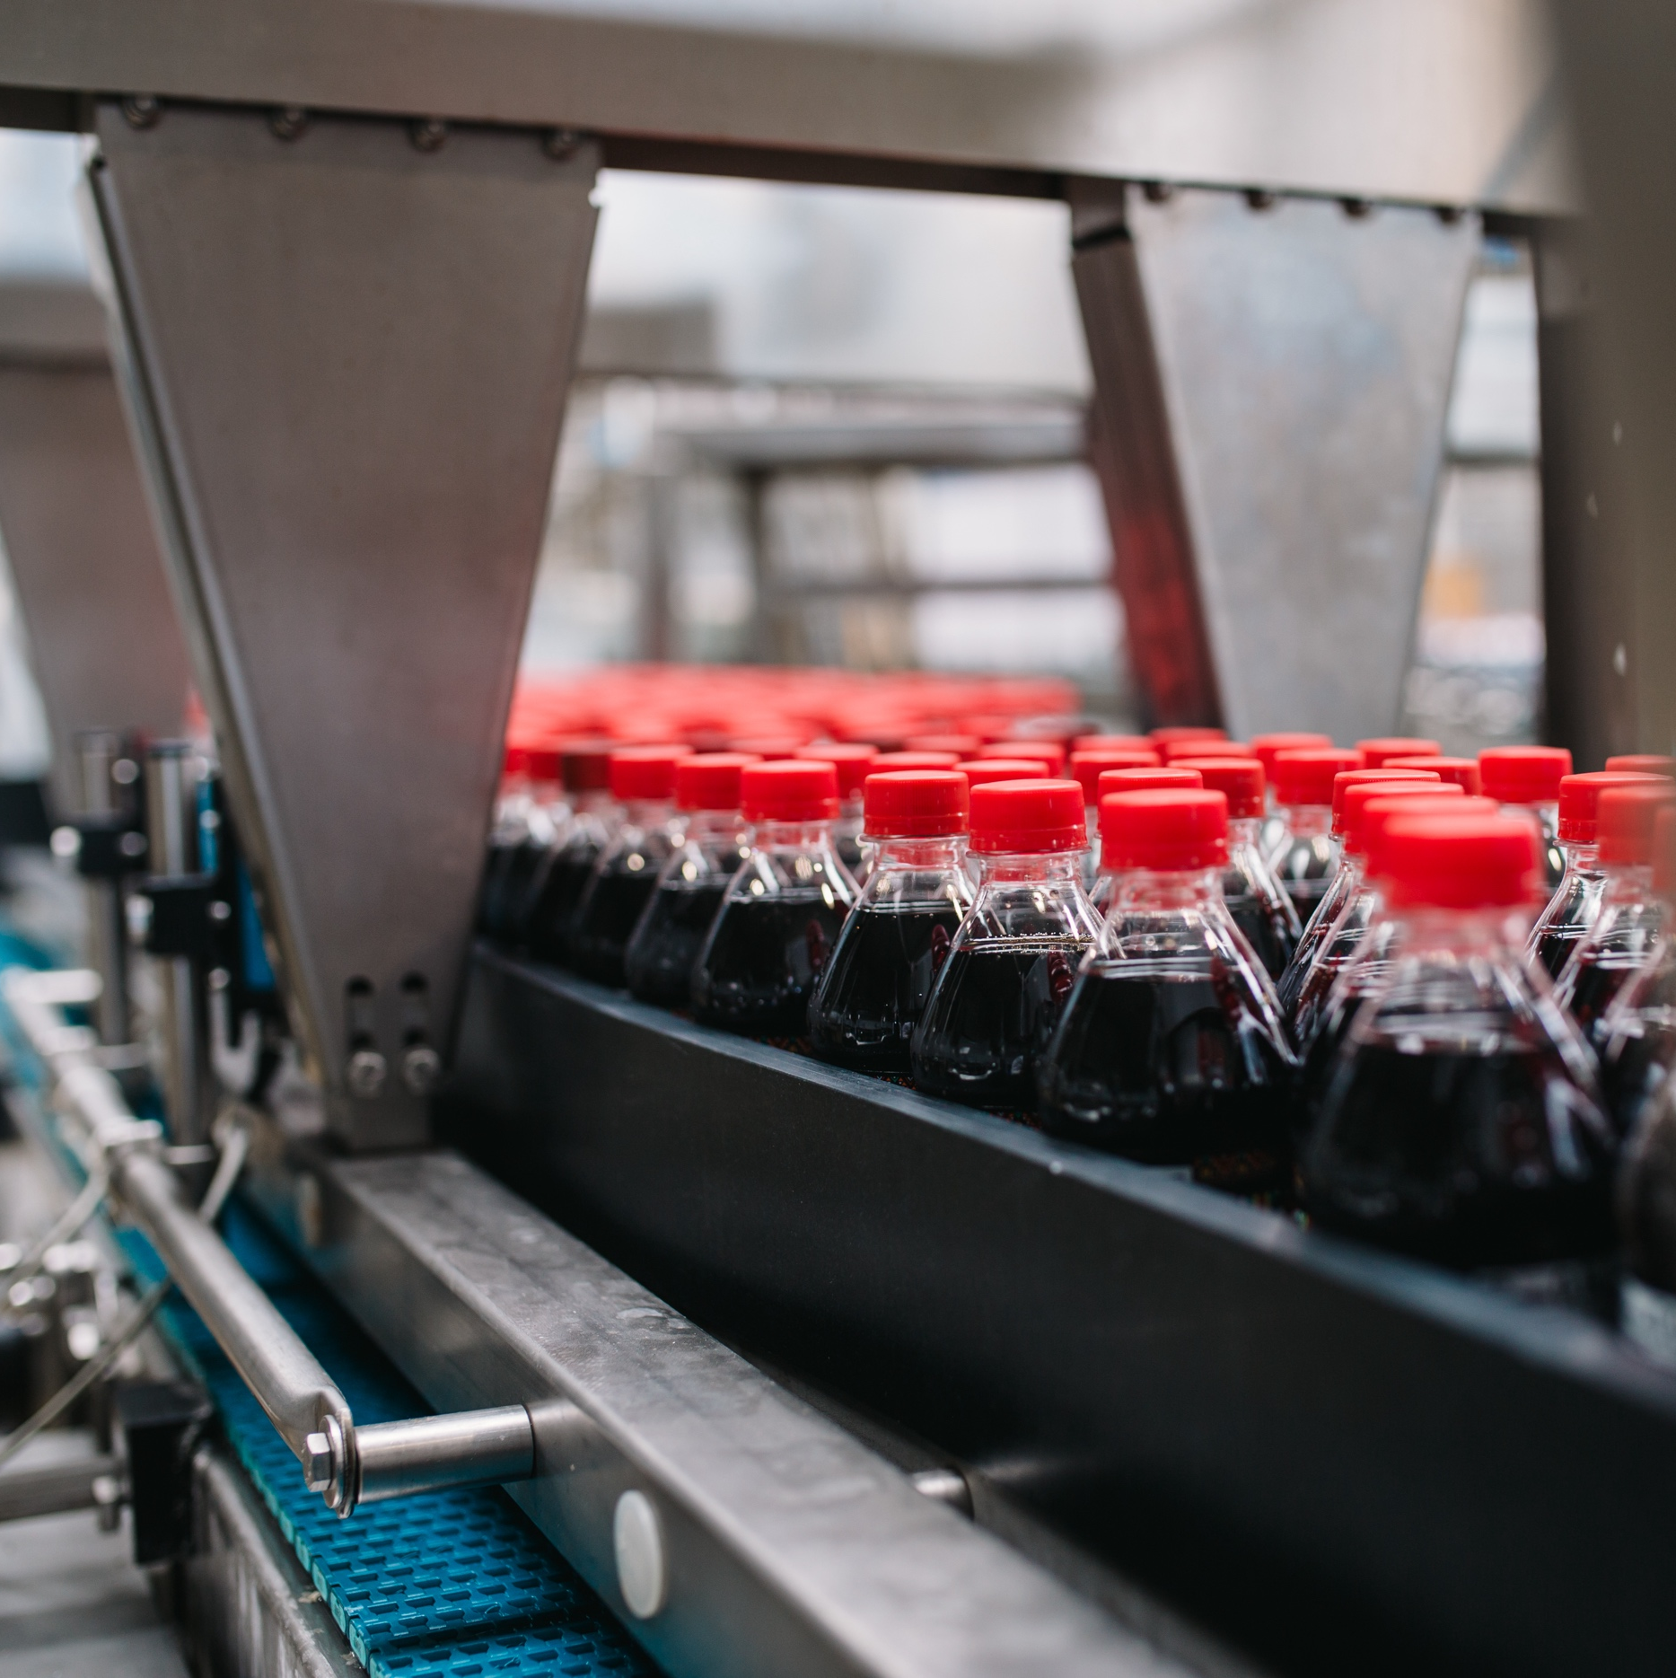
Industry Solution #1: High Speed Bottling – microstops, throughput, energy
Visualize & Analyze
Machine Efficiency
Throughput Improvement by access to efficiencies in real time using Sight Machine data flowing into 3D Scenes
AI Application
Power Use
Optimize power use with a machine learning deployed on top of data foundation that has pre-blended power and manufacturing data
AI Application
Micro Stops
Alarm Analysis across the line using Machine Learning to identify the root cause
Visualize & Analyze
CO₂ footprint across the value chain
Real time CO₂ footprint from the bottling lines combined with upstream operations
Visualize & Analyze
Operator Workflow
Automate workflow of operator activities with Power Platform and contextualize information back with Sight Machine
Co - Pilot
Enterprise use cases
Leverage manufacturing data to develop co – pilots for enterprise wide use cases. Example: Marketing, Supply Chain
Potential Targets:– ~10,000 bottling lines with 950 plants just within the Coca – Cola bottling ecosystem

